Slide 1
2018 Suburban Little League Youth Umpire Program
Umpire in Chief – Craig D’Angelo
Cr.dangelo@icloud.com
Cell/Text – 302-468-0087

Slide 2
2018 SLL Youth Umpire Program
Program Overview
Why is SLL developing a Youth Umpire Program?
For our young Ladies and Gentlemen, our program:
Develops Leadership, Responsibility, Confidence and sense of Accomplishment
Increases involvement with the neighboring community
Enhances understanding and application of the rules the game
Provides and opportunity to gain work experience in a challenging and safe environment
Opportunity to further an activity they love and in which they are already personally invested

Slide 3
2018 SLL Youth Umpire Program
Program Overview
Why is SLL developing a Youth Umpire Program?
Our youth umpires may be eligible for letters of recommendation and/or community service learning hours
Youth umpiring requires leadership, confidence and the ability to make decisions under pressure – all great items to include in college applications.
….. Oh yes, almost forgot …….. A chance to earn some extra spending money!

Slide 4
2018 SLL Youth Umpire Program
Program Overview
How many are in the program and what positions will I be filling?
We have are currently gathering numbers for interested individuals
Major Baseball Field Umpire
Major Softball Plate and Field Umpires
Minor A Baseball Plate and Field Umpires

Slide 5
2018 SLL Youth Umpire Program
Program Overview
How many games are there to cover and how much can I earn?
Major Baseball
$20 for Field Umpire
Major Softball
$20 Plate / $10 Field Umpire
Minor A Baseball
$20 Plate / $10 Field Umpire
Major Baseball Plate will be covered by DSUA umpires
Major Softball and Minor A Baseball will be covered by Youth Umpire(s). An adult will always be part of the umpiring crew or Game Coordinator.

Slide 6
2018 SLL Youth Umpire Program
Program Overview
Adult umpires or Game Coordinators?
Major Softball and Minor A Baseball Games will have either a manager from Major BB, Minor A BB or Major SB, or an adult umpire assigned.
If 1 youth umpire assigned –
Youth Umpire = Plate/Field
Adult (manager) Umpire = Plate/Field
If 2 youth umpires assigned
Adult (manager) may be a 3rd umpire or Game Coordinator.
Game Coordinator attends pre game meeting
Game Coordinator remains at game at all times
Game Coordinator watches over safety of game and umpires

Slide 7
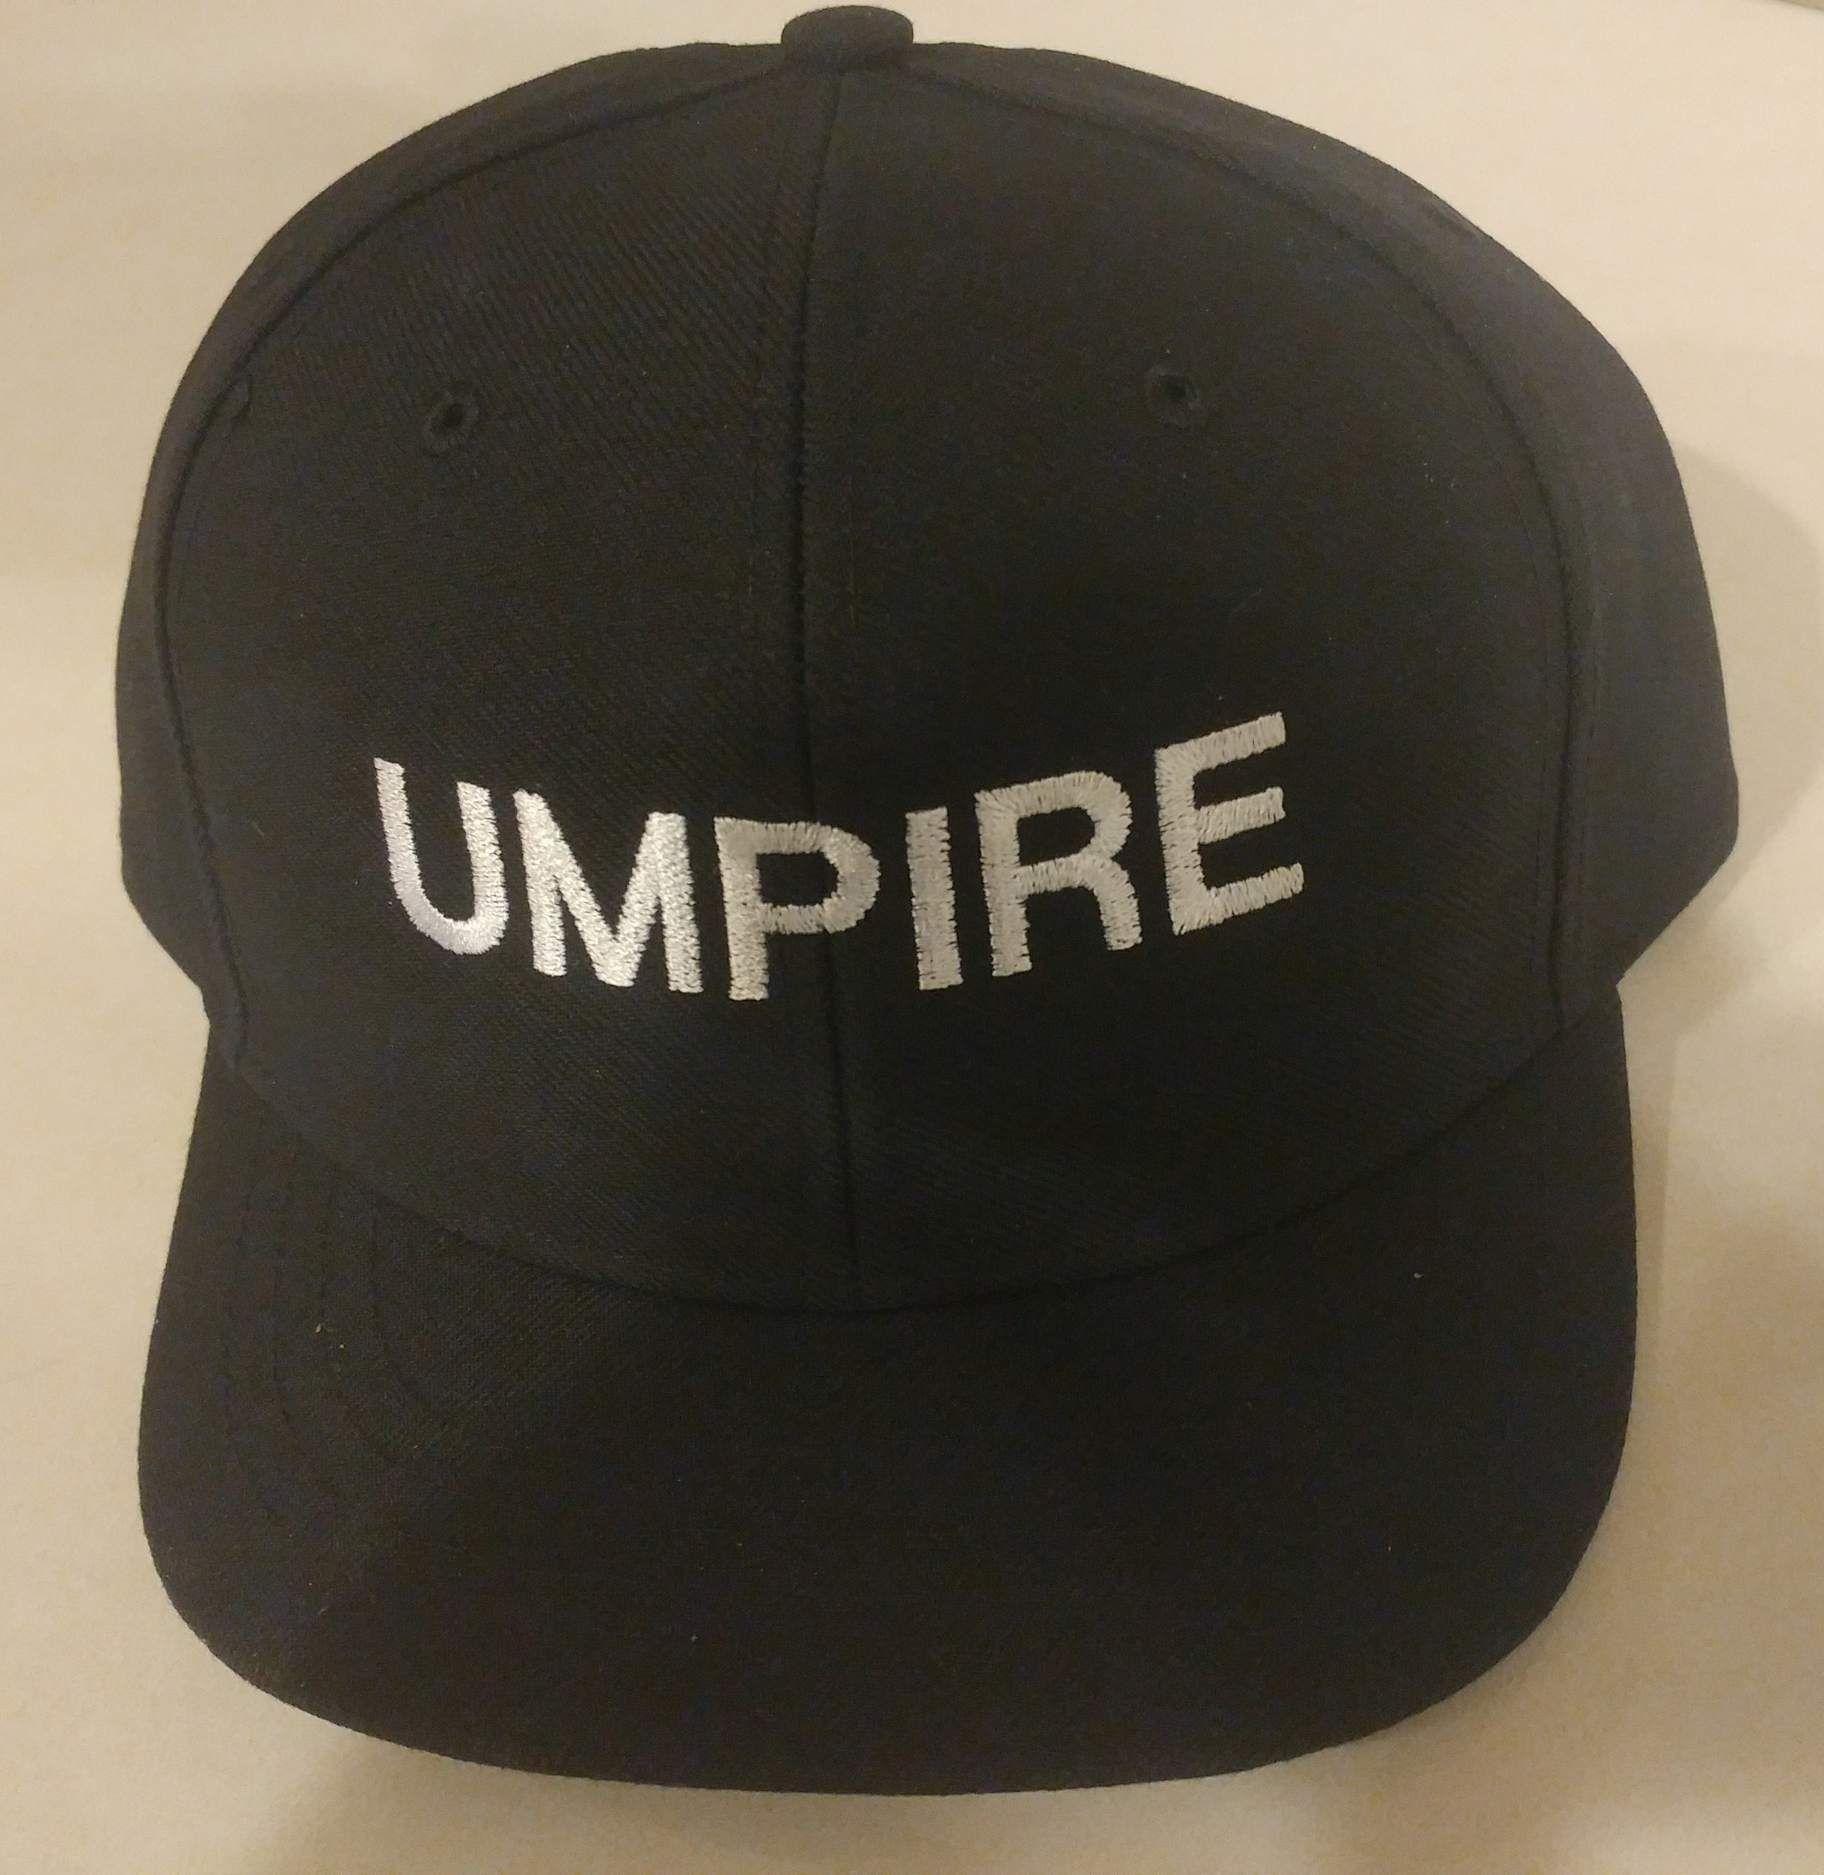
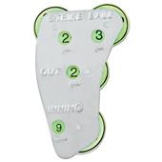
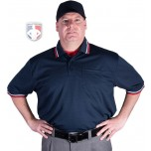
2018 SLL Youth Umpire Program
Program Overview
What is supplied and What items will I need to supply?
** Supplied and yours to keep**

Slide 8
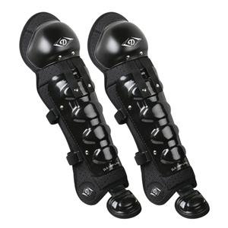
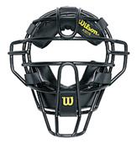
2018 SLL Youth Umpire Program
Program Overview
What is supplied and What items will I need to supply?
** Supplied and Returned after each game **

Slide 9
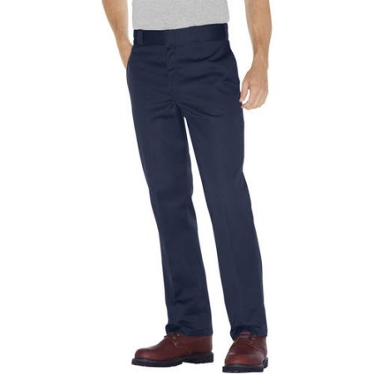
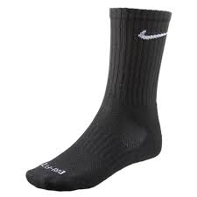
2018 SLL Youth Umpire Program
Program Overview
What is supplied and What items will I need to supply?
** Youth Umpire Needs to Supply **

Slide 10
2018 SLL Youth Umpire Program
Program Overview
How will I get selected for assignments?
Assignments are dependent on seniority, aptitude and demonstrated ability.
**** Your best ability is AVAILABILITY ****
Please ensure you complete the contact/information form prior to leaving today!!
Include as many ways to contact you as possible
Assignments will be made 1-2 weeks in advance
Posted and updated on website
Emergent Assignments often require quick/immediate responses

Slide 11
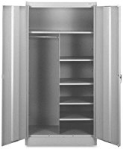
2018 SLL Youth Umpire Program
Program Overview
What will a typical game day look like?
Game protocol covered in meeting 3, however:
Arrive to the complex a minimum of 30 minutes prior to game time.
In the Umpire Locker in the clubhouse, obtain your protective equipment and game form.
After your game, return/clean your equipment and file game form in concession stand.
Communicate any questions/concerns to UIC.

Slide 12
2018 SLL Youth Umpire Program
Program Overview
When will I be compensated?
Compensation will be provided in CASH at the completion of your games for the day.

Slide 13
2018 SLL Youth Umpire Program
Program Overview
What happens after the regular season games are over?
Based on season performance, selected umpires will be given the opportunity to do Suburban playoff games. Depending on status of the budget at that time, these umpires may be eligible for playoff incentives.
Selected umpires may also be given the opportunity to volunteer for All Star umpiring positions. Positions may be available in tournaments such as 10YO District 2 and Brandywine Invitational.

Slide 14
2018 SLL Youth Umpire Program
Program Overview
Will my son/daughter be safe?
New for 2018, Suburban Little League is requiring Parents/Managers/Players to read and sign a ‘Code of Conduct’
In short – baseball is a game of interpretations and umpires are ‘in training’ as are the players. Umpires will receive the respect their position deserves and all on field discussion will be handled by the manager only and in a civil manner. A ‘zero tolerance’ policy will be implemented for inappropriate behavior.

Slide 15
2018 SLL Youth Umpire Program
Program Overview
Will my son/daughter be safe?
Insurance –
Little League International will only cover umpire injuries for volunteers. As a paid umpire, any injuries sustained while working will need to be covered 1 of 2 ways:
Through the individual’s medical insurance
Through a supplemental umpire insurance policy
Example – ABUA ($55/year covering all sports)

Slide 16
2018 SLL Youth Umpire Program
Program Overview
What’s next?
Required Forms / Uniform Sizes / Contact Information
Meeting 2 – Umpire Rules
Meeting 3 – Umpire Mechanics / Game Protocol
Scrimmage – Each umpire will be trained/evaluated doing a portion of a pre-season scrimmage game.
Opening day Saturday April 14th

Slide 17
2018 SLL Youth Umpire Program
Program Overview
What’s next?
Please Review your rulebooks in preparation for Meeting 2
Interesting new regular season rules:
6.02 – Batter must remain in the box with at least one foot throughout the at bat (local rule to be voted on by SLL)
6.08 – Prior to pitch being thrown, the defense may elect to intentionally walk batter with no pitches required to be thrown
9.01 – Stealing signs may lead to disqualification.

Slide 18
2018 SLL Youth Umpire Program
Program Overview
What’s next?
Please Review your rulebooks in preparation for Meeting 2
Homework:
Email one rule or situation from your rulebook that you didn’t know.
Email one question you have on any rule or situation from your rulebook. ----- Everyone has one.

